Slide 1
cornea
The cornea is a complex transperant structure which, as well as having a protective
role, is responsible for about three-quarters of the optical
power of the eye.
The normal cornea is free of blood vessels;
nutrients are supplied and metabolic products removed mainly via
the aqueous humour posteriorly and the tears anteriorly.
cornea is the most densely innervated tissue in the body

Slide 3
of cornea structure
Transparent.
Contain unmyelinated nerve endings . Very sensitive; touch, temperature and chemicals.
Avascular.
Dimensions:
Diameter : 11.5 mm
Thickness:center(0.5-0.6mm ), periphery ( 0.6-0.8 mm )
It borders with the sclera by the corneal limbus.

Slide 4
Why the cornea is transperant?
The cornea does not have blood vessels. It gets oxygen directly through the air.
It receives nutrients via :
-diffusion from the tear fluid and the aqueous humour.
Unmyelinated nerve endings.
relative dehydration of cornea
Regular arrangement of collagen fibiril

Slide 6
From out to in :
1-Corneal epithelium | - 10% of the thickness. - Stratified squamous epithelium ; fast growing and easily regenerated. - Basement membrane ; on which the epithelium is anchored and organized.
2- Bowman's layer | - Irregularly arranged collagen. - Protects the stroma.
3-Corneal stroma | -90% of thickness -Consists primarily of water (78 percent) and collagen (16 percent); regularly arranged. -Collagen gives the cornea strength, elasticity, and form Keratocytes.
4-Descemet's membrane | - A thin acellular layer; collagen( by endothelial cells ) Modified basement membrane of the endothelium. - Descemet's membrane is regenerated readily after injury.
5-Corneal endothelium | -The thinnest layer. -Simple squamous or low cuboidal monolayer. -Regulating fluid and solute transport. - NO WAY BACK - If too many endothelial cells are destroyed, corneal edema and blindness ensue.

Slide 7
Physiology of the cornea.
The corneal endothelium is :
-Monolayer of specialized, flattened, mitochondria-rich cells .
-Lines the posterior surface of the cornea and faces the anterior chamber of the eye.
-Governs fluid and solute transport.
-Actively maintains the cornea in the slightly dehydrated state.

Slide 8
Bacterial keratitis
Bacterial keratitis usually develops only when ocular defences have been compromised. However, some bacteria, including
Neisseria gonorrhoeae, Neisseria meningitidis, Corynebacterium diphtheriae and Haemophilus influenzae are able to penetrate
a healthy corneal epithelium,

Slide 9
Bacterial keratitis
Comon causative organisms:
Pseudomonas auroginosa
Staphylococcus aurues
Streptococucs pyogenus
Streptococucs pneumonie

Slide 10
Risk factors
Risk factors
• Contact lens wear, particularly if extended, is the most
important risk factor. Corneal epithelial compromise
secondary to hypoxia and minor trauma
• Trauma
In developing countries agricultural injury is the major risk
factor, when fungal infection should be considered.
• Ocular surface disease such as herpetic keratitis, bullous
keratopathy, dry eye.
local or systemic immunosuppression,

Slide 11
Bacterial keratitis

Slide 12
Bacterial keratitis with hypopyn

Slide 13
Complications:
Corneal perforation –
2ndary endopthalmitis
Vision loss
Irregular astigmatism (uneven healing of stroma)
Corneal opacity

Slide 14
Treatment:
Initiate topical broad-spectrum antibiotics:
tobramycin (aminoglycoside gram -ve) alternating with fortified cefazolin (cephalosporin).
If the corneal ulcer is small, peripheral and no impending perforation is present, intensive monotherapy with fluoroquinolones is an alternative treatment.
Corneal graft ( in severe cases) .

Slide 15
HERPES SIMPLEX KERATITIS
HSV 1: common viral cause of ocular diseases
HSV 2: genital dis. Rarely can cause ocular manifestations such as keratitis & infantile chorioretinitis.
Primary infection is usually early in life
Enters a latent period in the trigeminal ganglion,
When activated it moves along the sensory part of the N. toward the target epith. causing damage & ulceration.
Factors leading to activation :psychiatric stress. , systemic illnesses, immunocompromised pt.

Slide 16
Symptoms:
-Typically unilateral red eye
- Ocular pain
-Ocular irritation
-Tearing
-Vision may or may not be affected
-Vesicular skin rash and follicular conjunctivitis

Slide 17
Signs:
A dendritic corneal ulcer (hallmark sign of HSV infection)
Ulcer may heal without scar but may progressed to stromal keratitis
Associated with inflammatory infiltration and edema
Loss of corneal transparency in more severe presentations.
Uveitis and glaucoma may accompany disease

Slide 18
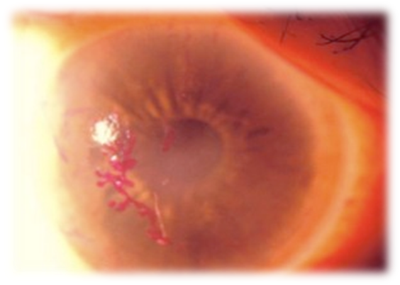
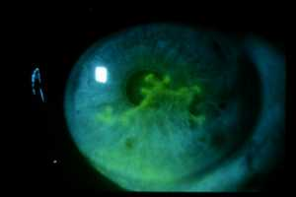
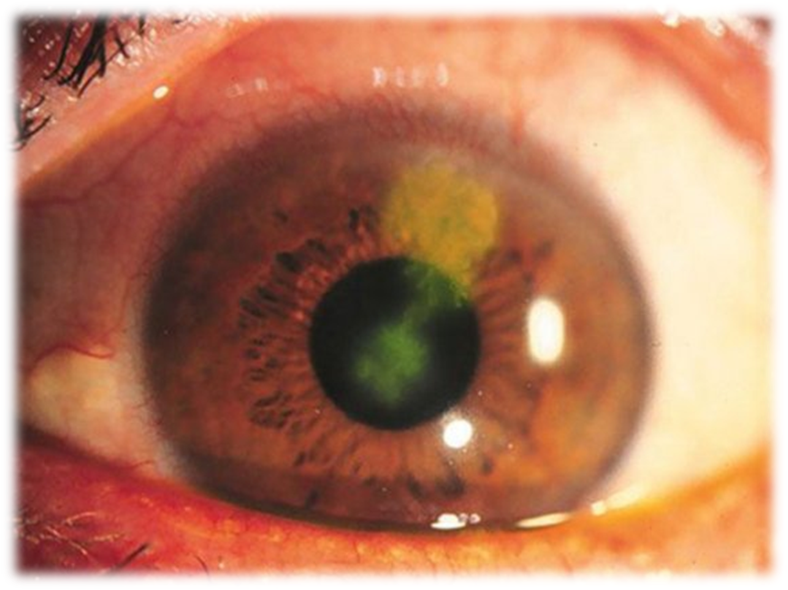
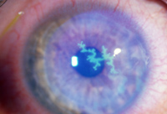
Herpes simplex keratitis
.

Slide 19
Herpes simplex keratitis
Diagnosed with a slit lamp examination
Treatment :
topical antivirals – acyclovir ointment
DON’T USE TOPICAL STEROIDS as they worsen the ulcer to geographic ulcer
If recur more than twice a year give oral acyclovir

Slide 20
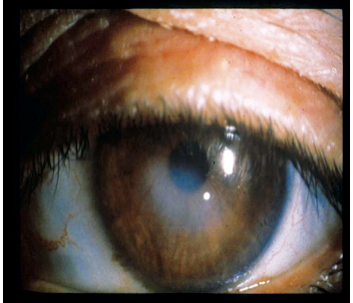
Disciform keratitis:
reaction to herpes virus antigens resulting in stromal edema & clouding w/o ulceration
Often associated with iritis.

Slide 21
HERPES ZOSTER OPTHALMICUS
Varicela zoster virus -affect the ophthalmic division of the trigeminal N. (15% )
Increases with age (6th-7th decades).
The ocular manifestations are more likely if the nasocillary N. is involved >>lid swelling (maybe bilateral), keratitis ,iritis, secondary glaucoma.
Other ocular manifest. :ptosis, mucus secreting conjunctivitis, neuralgia& scleritis which may lead to scleral atrophy.

Slide 22
Symptoms:
Have prodromal period, typically presents with nondescript facial pain, fever and general malaise.
About four days after onset, a unilateral vesicular skin rash over forehead, upper eyelid, nose (1st div of 5th CN), characteristically respecting the vertical midline. The vesicles will discharge fluid and begin to scar over after about one week. The pain is extreme during the inflammatory stage, and patients are tremendously symptomatic.

Slide 23
Hutchinson’s Sign
Lesions at tip, side, root of
nose
Innervated by ant. ethmoidal
branch of nasociliary N.
Nasociliary N. also innervates
cornea & ciliary body

Slide 25
Signs:
Cornea: Punctate epithelial keratitis (swollen epithelium, 1-2 d); dendritic keratitis (tree branchlike epithelial defects, 4-6 d); stromal keratitis (fine infiltrates beneath the surface, 1-2 wk); deep stromal keratitis (lipid infiltrates and corneal neovascularization, 1 month to years); neurotrophic keratopathy (erosions, persistent defects, corneal ulcers, months to years)
Ocular involvement may include follicular conjunctivitis, epithelial and/or interstitial keratitis, dendritic keratitis, ant chamber uveitis, scleritis or episcleritis, chorioretinitis, optic neuropathy, and even neurogenic motility disorders (especially fourth cranial nerve palsy).
Prognostic indicator: Hutchinson’s Sign

Slide 26
Treatment:
Oral and topical antiviral : Acyclovir ( prevent post-infective neuralgia-severe chronic pain over the rash)
+/- a cycloplegic agent.

Slide 27
Fungal keratitis
Fungal keratitis is rare in temperate countries but
is a major cause of visual loss in tropical and developing countries.
Though often evolving slowly, fungal keratitis can elicit a
severe inflammatory response –
corneal perforation is common,
Two main types of
fungi cause keratitis:
• Yeasts (e.g. genus Candida),
• Filamentous fungi (e.g. genera Fusarium and Aspergillus),
e

Slide 28
we should put Keratomycosis in consideration when we find lack of response to antibacterial therapy of corneal ulceration.
Signs include :
Filamentous infections: grayish infiltrate with indistinct margins
Candidal infections: yellow to white ulcer with suppuration similar to bacterial keratitis.
Treatment: topical antifungals .

Slide 29
sever candidal keratitis

Slide 30
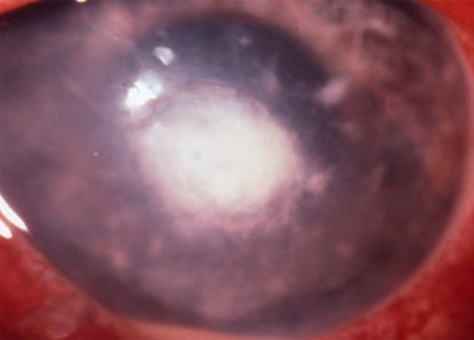
Filamentous fungal keratits fluffy edge with satellite lesion

Slide 31
Acanthamoeba keratitis
Protozoa found in air, soil , fresh or brackish water.
This infection has become more common with
increased soft contact lens user.
Severe persistent painful infection & the corneal nerves are infiltrated.
I
DX is by scraping of the amoeba from the cornea & culture on a special plate with E.coli.

Slide 32
Treatment :
Is long, involves toxic medications, and may be unsuccessful in curing the infection if involves the posterior cornea.
A combination of topical anti-amoebic agents, including biguanides (eg, PHMB (polyhexamethylene biguanide) and chlorhexidine, diamidines (eg, propamidine) and aminoglycosides (eg, neomycin) are typically used.
The use of topical steroids is controversial. It clearly improves patient comfort, but may potentiate the infection by conversion of the cyst to trophozoites.

Slide 33
Acanthamoebic Keratitis, Perineural Infiltrate:typical are an irregular epithelium without defects, localized stromal edema with infiltration.

Slide 34
KERATOCONUS

Slide 35
DEFINITION
Greek words: kerato = cornea;
conus = cone-shaped
Is a non-inflammatory condition of the cornea in which there is progressive central thinning of the cornea changing it from dome-shaped to cone-shaped. Causing vision to become blurred and distorted.
Classification:
Based on severity of curvature
Based on shape

Slide 36
Epidemiology
Ages 10-25
Females, South Asian
Progresses gradually over 10-20 or more years then stabilizes

Slide 37
Based on severity of curvature
Mild : less than 48.00D
Moderate : 48.00 to 54.00D
Severe : more than 54.00D
Based on shape:
Nipple cones (Small size 5mm )
Oval cones (larger (5-6mm) ellipsoid)
Globus cones (Largest >6mm ,may involve over 75% of cornea. )

Slide 38
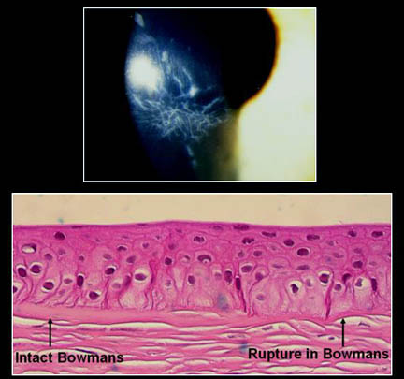
PATHOPHYSIOLOGY
All layers of the cornea are believed to be affected by KC, most notable features are the.
1. Thinning of the corneal stroma.
2. Ruptures in the Bowman layer.
3. Deposition of iron in the basal epithelial cells, forming the Fleischer ring.
4. Breaks in and folds close to the Descemet membrane result in acute hydrops and striae, respectively.

Slide 39
Etiology
Unclear, some multifactorial genetics
Associated with Down syndrome, Turner’s syndrome, atopic disorders, connective tissue disorders, eye rubbing, vernal keratoconjuctivitis

Slide 40
Signs and Symptoms
Progressive astigmatism
Eventually unable to correct with glasses or soft contacts
Night vision and far vision worsen
Photophobia, itching, “ghost images” (monocular polyopia)

Slide 41
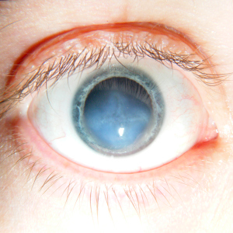
Signs and Symptoms
Corneal hydrops- bulging cornea breaks Descemet’s membrane causing aqueous humor to flow into cornea, sudden pain and cloudy vision
Resolves 6-8 weeks
Corneal scarring but can flatten cornea

Slide 42
The Classic Signs Of Keratoconus
Slit lamp
Fleischer's ring (an iron colored ring surrounding the cone)

Slide 43
Vogt's striae (stress lines caused by corneal thinning)
Apical scarring (scarring at the apex of the cone).

Slide 44
Corneal thinning:
In advanced cases, the thinning of the central cornea can be seen on examination.

Slide 45
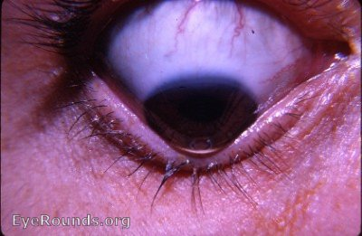
Munson's sign:
It’s an angulation of the lower lid during inferior gaze due to corneal protrusion

Slide 46
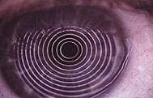
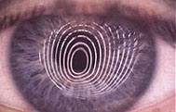
Photokeratoscope with
normal round curvature
Note the distorted pattern of the rings

Slide 47
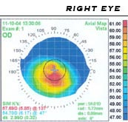
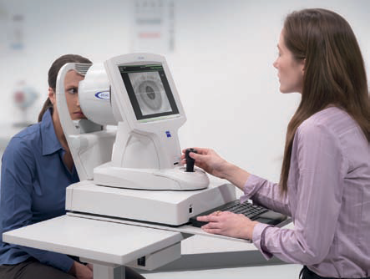
Diagnosis
Computerized Corneal Topography to analyze the curvature of the cornea shows steep curvature usually inferiorly

Slide 48
Treatment
spectacle or soft contact lenses in early stage
Rigid contact lens
Corneal ring segments- flattens the cornea making contact lens fitting easier, and slows progression, removable
Penetrating keratoplasty (full cornea transplant)- may get recurrence, low rejection rate or DALK
Collagen cross-linking …strengthens cornea and prevents progression using riboflavin activated by UV light

Slide 49
Treatment
2 Intrastromal Corneal Ring Segments (Intacs)

Slide 50
Definition
Laser-Assisted in SItu Keratomileusis
Light Amplification by Stimulation of Emmitted Radiation.
Refractive Surgery used to correct:
myopia
hyperopia
astigmatism
Notes:
The word is derived from Greek κέρας- keras (root: kerat-) "horn, cornea" and σμίλευσις- smileusis "carving”
A laser is a device that emits light through a process of optical amplification based on the stimulated emission of electromagnetic radiation.
Lasers differ from other sources of light because they emit light coherently. Its spatial coherence allows a laser to be focused to a tight spot, and this enables applications like laser cutting.
Myopia: Ligth is focused in front of the retina, causing “farsightedness” difficulty seein far.
Hyperopia: Ligth is focused in front of the retina, causing “nearsightedness” difficulty seeing near.
Astigmatism is an optical defect in which vision is blurred due to the inability of the optics of the eye to focus a point object into a sharp focused image on the retina. This may be due to an irregular or toric curvature of the cornea or lens

Slide 51
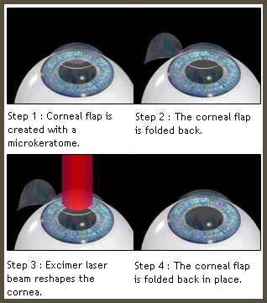
Surgical Steps
Anesthetic is applied to eye
Corneal Flap created with a mechanical keratome, or with the femtosecond laser (IntraLASIK)
Computer-controlled pulses of cool laser light(192nm) are applied to the inner layers of cornea to resurface and reshape to achieve the refractive.
Flap replacement
After checking for air pockets and any other debris that could hinder the healing process, corneal flap is replaced and aligned it to its original position. It heals naturally and securely.
Notes:
2. At this point patients experience blurry vision and can only see the laser light and the overhead light.
A microkeratome is a precision surgical instrument with an oscillating blade. The normal human cornea varies from around 500 to 600 micrometres in thickness; and in the LASIK procedure, the microkeratome creates a 83 to 200 micrometre thick flap.
3. For precise correction, an eye-tracking device tracks your eye movements up to 4,000 times per second.
4. After the tissue is reshaped, the corneal flap is carefully repositioned.

Slide 52
Contraindications
Collagen vascular
autoimmune or immunodeficiency diseases
pregnant or nursing women
signs of keratoconus or abnormal corneal topography or who
medications eg.amiodarone hydrochloride

